Slide 1
NACRO 2022 ANNUAL REPORT
Presentation to Development Committee
February 2023
Lusaka, Zambia

Slide 2
Presentation Outline
1. Strategic Focus & Results Areas
2. Overview of Programmes Implemented
3. Education Programmes 4. Survival and Vocational Skills
5. Health Programmes
6. WASH Programmes
7. Adaptation Programmes
8. Organisational Development
9. Response to Disasters in 2022
10. Prospective Projects
11. Conclusions

Slide 3
1. Strategic Focus & Work Areas
OUTCOMES
The livelihoods of the vulnerable households that live in the targeted communities are improved and their living standard enhanced | The resilience of the families and communities that are at higher risk of external shocks and disasters is strengthened and they are able to cope with and recover from such calamities.
OUTPUTS
1 Increased access to better educational services, incl. nursery, primary, secondary, and adult literacy learning - by Disadvantaged & vulnerable community members | 2 Strong survival and vocational skills – by Female and male youths from marginalised family backgrounds | 3 Improved health services, including the adolescent reproductive health services – for Women and men living in poverty in the targeted communities | 4 Increased access to safe and clean drinking water and improved sanitation facilities - for Many poor families living in challenging conditions have | 5 Enhanced Adaptive capacities of the targeted vulnerable - to meet their food and nutrition security and increase their incomes | 6 High level of preparedness and ability to cope with shocks – by Communities and families that live in areas prone to disasters such as floods and droughts have.

Slide 4
2. Overview of Programmes Implemented
Education Services | Livelihood & Survival Skills | Health services | Water, Sanitation & Hygiene | Adaptive Capacity | Resilience | Governance
NAC School Development | Chabota Vocational Skills Training Centre | Graceland Rural Health Centre (Mkushi) | Climate Resilient WASH in schools (Kalabo) | Promotion of Small-Scale Entrepreneurship (DSIK) | Response to Disasters in 2022 | Chibombo Farm
OVC Care & Support (Kalabo – closed 2022) |  | Accelerating Towards Epidemic Control (Kalabo & Kaoma) |  | Energy Cooperatives for Farmers |  | Zamfield Tomato Products
Choma OVC Support - closed 2022 |  | Covid-19 Response |  |  |  | Chitenge Rights
Covid-19 Response (29 NAC + Kalabo schools) |  | OVC Care and Support (Kalabo)

Slide 5
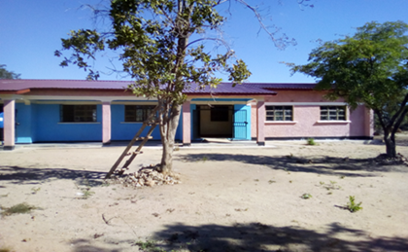
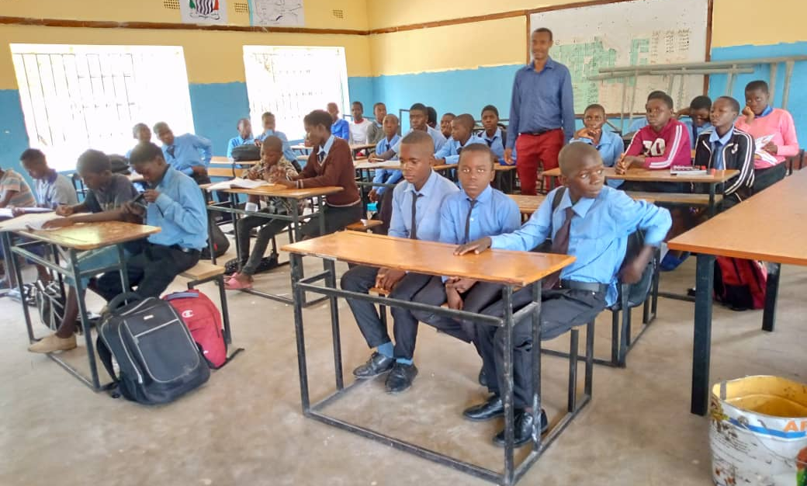
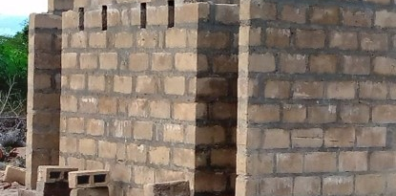
3. Education - NAC School Establishment (I)
OUTPUT 1:
Access to Education to vulnerable school going children.
NACRO is supporting establishment of the 3 NAC basic schools in Zambia - Makapaela, Matenda and Ganda.
NACRO is collaborating with GRZ in supporting the grant-aided schools. GRZ provided basic office furniture & desks to the 3 schools
In 2022, GRZ gave Makapaela School approved Grade 9 examination centre authority, effective from 2023
In 2022, GRZ provided more teachers to the 3 schools - Makapaela = 6, Matenda = 3 (2 reported), and Ganda = 3.
Matenda Community Education Support Project
Ganda Community School & Project
Makapaela NAC Primary School

Slide 6
3. Education - NAC School Establishment (II)
OUTPUT 1:
Access to Education to vulnerable school going children.
In 2022, NACRO, through the Covid-19 Response project, provided:
Computer labs for Matenda & Chabota Skills Training Centre
Textbooks in various subjects, provided for the 3 schools
4 latrines each for Matenda and Makapaela schools
Multiple user handwashing stations for Matenda & Makapaela
Handwashing stand, basin, buckets, hygiene soaps, hand sanitisers, liquid handwash soaps, thermometers - for the 3 schools and the 25 (+3) schools in Kalabo).

Slide 7
3. Education – NAC School Establishment (III)
OUTPUT 1:
Access to Education to vulnerable school going children.
Inadequate housing for teachers is a main constraint the 3 schools – esp. given increased number of teachers. There is need to address this to mitigate teachers leaving for better resourced schools.
Makapaela School, for instance, has 9 teachers, but only 4 houses. NAC International Sisters fellowship held in Mongu in 2022 contributed 75 roofing sheets to the school just enough for 2-3 semi-permanent houses.
NACRO has submitted a proposal to NAK-karitativ for e.g. 2 x 1x2 bedroomed houses at each school.
Shortage in Educational Housing Infrastructure

Slide 8
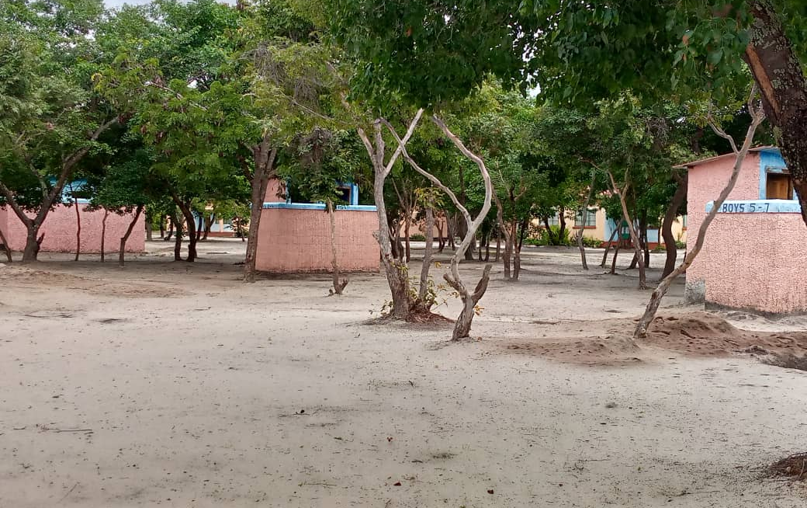
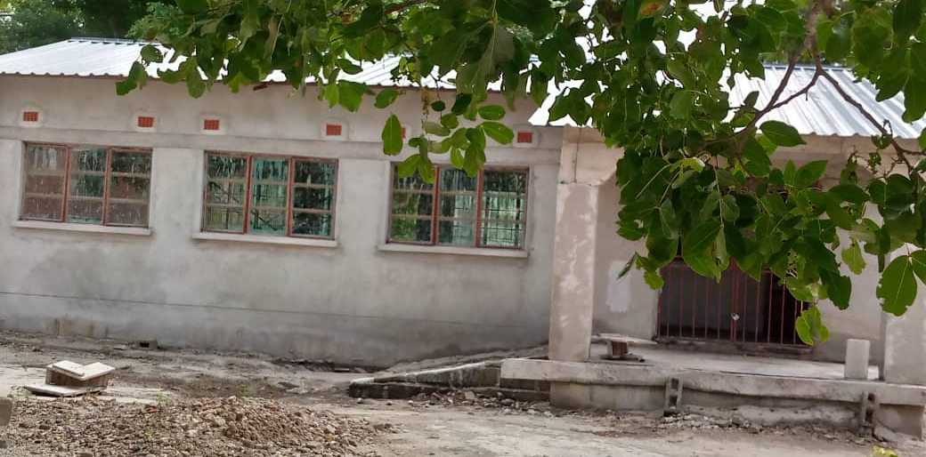
3. Education Programmes – Makapaela School
OUTPUT 1:
Access to Education to vulnerable school going children.
Makapaela School hosting Grades from ECDE and 1 to 9, has improved infrastructure and service capacity –
Enrolment increased from 199 pupils in 2021 to 251 by 2022
School has a new, yet to be equipped, computer room
School has 4 new toilets for pupils (doubles) and staff (singles)
School has received 6 new teachers including for Junior Secondary
GRZ has assigned the school Approved Grade 9 Examination Centre status from 2023
Makapaela NAC Primary School

Slide 9
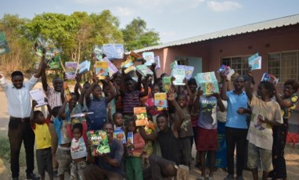
3. Education Programmes – Matenda School
OUTPUT 1:
Access to Education to vulnerable school going children.
Matenda School has increased service delivery capacity in 2022:
Enrolment increased from 198 pupils in 2020 to 208 in 2021 and 251 by 2022
School has 4 new toilets nearing completion - for pupils (doubles) and staff (singles)
School has a new, yet to be equipped, computer room
School has increased number of trained teachers, receiving 3 new teachers in 2022
School registered 100% progress at Grade 7
Matenda Community Education Support Project

Slide 10
3. Education Programmes – Ganda School
OUTPUT 1:
Access to Education to vulnerable school going children.
Ganda School is serving 845 households in Ganda, in education service.
Enrolment has increased from …in 2019 to 293 learners in 2022 (144 boys, 149 girls) - currently 308 leaners)
1x3 classroom block, 2 teachers’ houses & 5 latrines serving school
3 new teachers deployed to the school = 5 teachers. A Head Teacher and his wife as Deputy Head.
NACRO provided Ganda school with 19 text books in each of 6 subjects.
Ganda Community School & Project

Slide 11
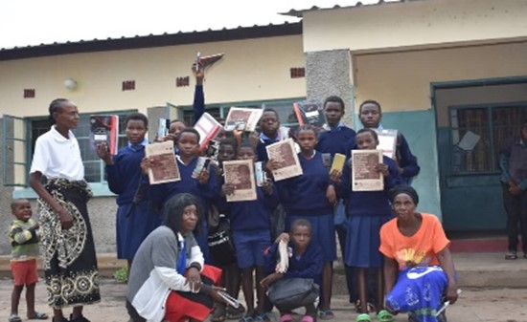
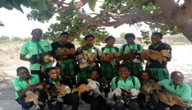
3. Education Programmes – OVC Care and Support
OUTPUT 1:
Access to Education to vulnerable school going children.
Implemented with PEPFAR funds, to increase access of 40 OVC to quality education - in 3 Kalabo schools (Mapungu, Malasha, & Ng’unyama)
School requisites provided to 40 OVCs - hardcover books, pens, mathematical sets, and a full uniform
In-kind support to supplement 40 OVCs – 4 free-range chickens for each
Sexual & reproductive health education – 3 schools conducted 4 health services sessions; reaching 557 adolescents (181 boys & 376 girls).
OVC Care and Support (Kalabo)

Slide 12
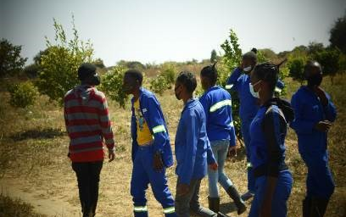
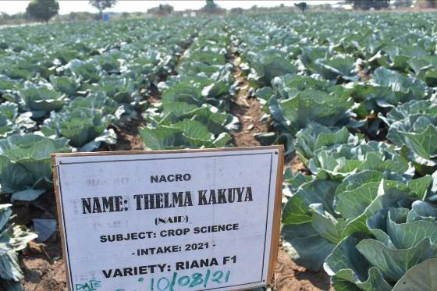
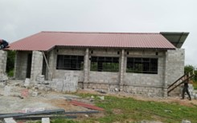
4. Survival and Vocational Skills – Chabota Training Centre
OUTPUT 2:
Survival and vocational skills – by Female and male youths from marginalised family backgrounds
Chabota Vocational Skills Training Centre aims to develop strong survival and vocational skills of the youths from marginalised families.
1st cohort of 19 in 2020; 2nd cohort of 28 students in 2021; 3rd cohort of 29 of 2022 on practical attachment.
Collaborating with commercial farmers – e.g. with Savenda
Short courses are being developed targeting farmers who will be called in during the recesses of the school for sessions at a fee.
Through Covid-19 Response project, a 1 x 2 computer lab is under construction at Chabota Centre;
Chabota Vocational Skills Training Centre (Chibombo)

Slide 13
4. Survival and Vocational Skills – Choma OVC project
26 women and youths were trained in vocational skills (17 in tailoring and 19 in carpentry) - in Choma; Trainees were later given sewing machines and carpentry equipment.
The women trained in tailoring are making money through sewing uniforms for nearby schools and a nursing college, as well as making face masks during the peak of the Covid-19.
Trainees were also oriented in self-help savings and credit
OUTPUT 2:
Survival and vocational skills – by Female and male youths from marginalised family backgrounds
Choma OVC project (Choma – closed 2022)

Slide 14
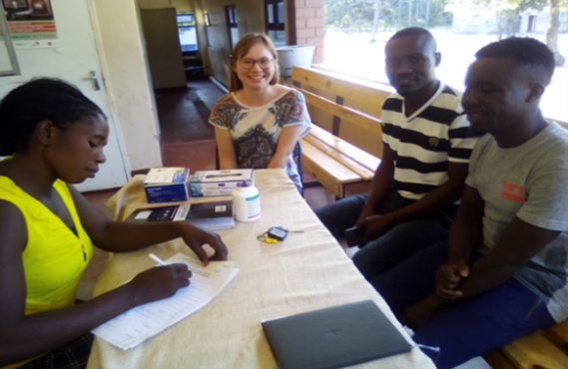
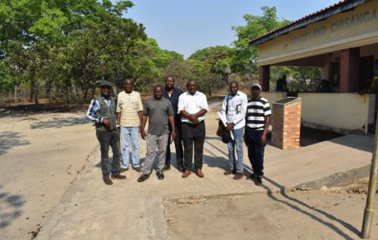
5. Health Programmes – Graceland Health Centre
OUTPUT 3:
Access to Improved health services, incl. adolescent reproductive health services
Graceland Rural Health Centre provides primary health care and other services to more than 3000 households in the Chisanga, Mkushi..
In 3rd Quarter of 2022 Graceland received a grant of K700,000 from NAC Zambia for construction of 2 No. 1 x 3 bedroomed staff houses. Procurement started in 2022 but reviewed to employ labour-based contractor for affordability..
Graceland also received 2 trained personnel (registered nurses) through Mkushi Health Management office.
Graceland Rural Health Centre (Mkushi)

Slide 15
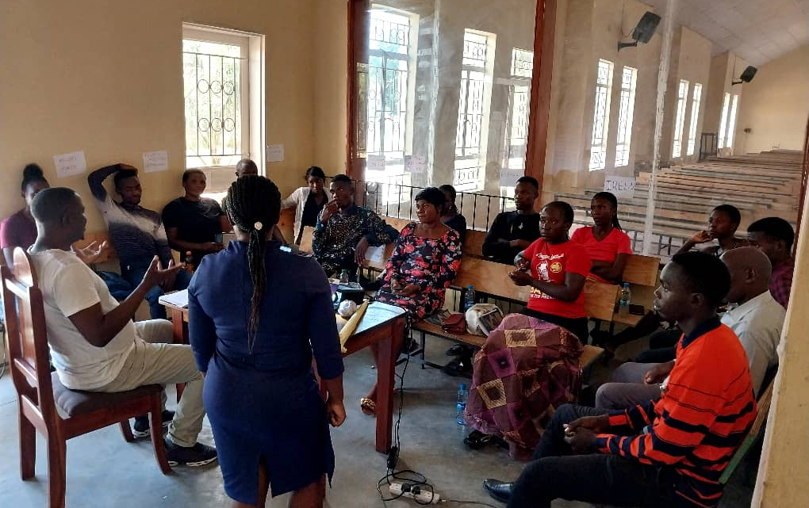
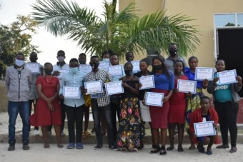
5. Health Programmes – ATEC II
OUTPUT 3:
Access to Improved health services, incl. adolescent reproductive health services
Since 2022, NACRO implements ATEC II towards control of TB, HIV, & Covid-19 (with Expanded Church Response funding). In 2022, results were:
Covid-19 + HIV/AIDS - 45 community health trained in Kalabo, 30 in Kaoma.
TB services - 30 CBVs trained in Kalabo, and 30 in Kaoma.
15 trained as paralegals in Kaoma
30 GBV victims given transport money
120 girls trained in defensive skills in Kaoma & Kalabo
Accelerating Towards Epidemic Control (Kalabo & Kaoma – 2022 23)

Slide 16
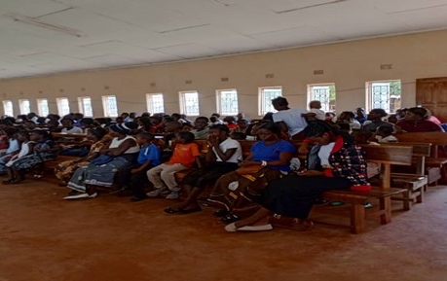
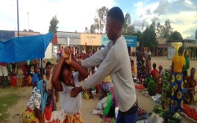
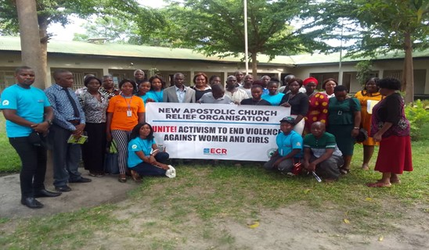
5. Health Programmes – ATEC II + Gender
OUTPUT 3:
Access to Improved health services, incl. adolescent reproductive health services
In December 2022, ATEC II provided additional funding for rolling out gender activism in Kalabo and Kaoma.
NACRO engaged in stakeholder discussions, community dialogues and sensitisation. Outreach was:
In Kaoma, 2173 people were reached (650 male, 1523 female).
In Kalabo, 889 people were reached (368 male, and 551 female). One performance is here: https://youtu.be/qpahVNnyiaE
Kaoma & Kalabo DDCC gender committees developed gender activism plans for 2023.
ATEC II support to 16 Days of Activism Against Gender-Based Violence

Slide 17
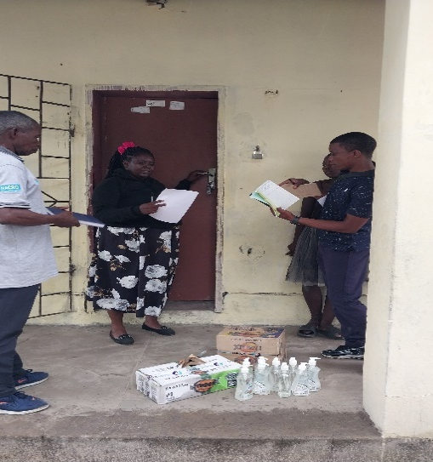
5. Health Programmes – Covid-19 Response & Recovery
OUTPUT 1:
Access to Education to vulnerable school going children.
Covid-19 Response & Recovery promotes the wellbeing of Covid-19 affected communities through provision of WASH and school infrastructure at target schools. Results for 2022 include:
Over 7000 school children, teachers & community members access WASH services; reduced incidence of sanitation related
Children, adolescents and adults adopt positive behaviour and attitudes in personal & environmental hygiene
School infrastructure & hygiene kit supplies enabling continuity of learning even under epidemics.
Covid-19 Response & Recovery Project

Slide 18
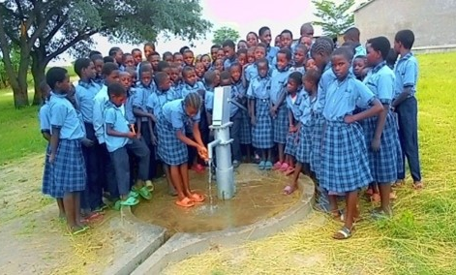
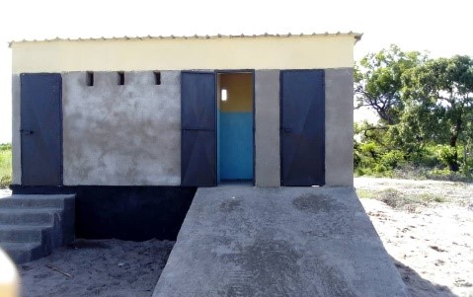
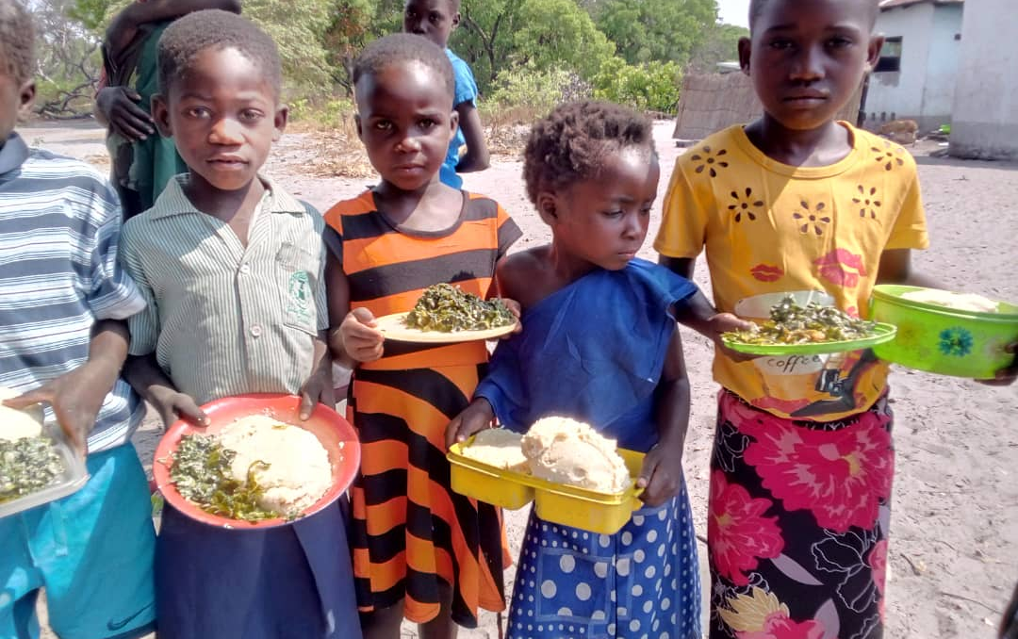
6. WASH Programmes – WASH - Kalabo Schools
OUTPUT 4:
Access to safe and clean drinking water and improved sanitation
CREWASH aims to increase access to safe drinking water and sanitation through WASH infrastructure, and services in 25 schools in Kalabo. Results in 2022:
4 boreholes rehabilitated in 2022; cumulative since inception = 14.
2 solar boreholes drilled in 2021 still functional in 2022.
7 boreholes equipped with handpumps drilled in 2022; cumulative = 11.
9 double latrines, 9 double latrines with bathrooms (for girls) and 18 single latrines constructed; cumulative = 19 doubles for boys, 19 doubles for girls and 38 singles for teachers
Schools supplied gardens inputs, and grow vegetables for school feeding and revenue to supplement operations.
Climate Resilient WASH in schools of Western Province (Kalabo – 2021 - 2023)

Slide 19
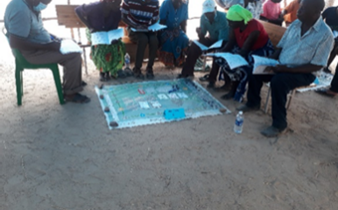
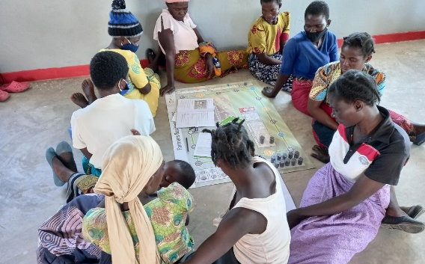
7. Adaptation Projects – Entrepreneurship (DISK) (I)
NACRO partnered with the German Sparkassenstiftung for International Cooperation (DSIK) to implement the Farmer Business Simulation Games (FBG) solution in a 3-year project. The project is being implemented in Zambia, Malawi, Zimbabwe
Since April 2021, NACRO is implementing a practical understanding on income & expense management under simulated events throughout a business/farm life span in the self-help savings groups
DSIK manages and steers the Farmer Business Simulation Games model rom the Zambia.
OURPUT 5: Enhanced Adaptive capacities of the targeted vulnerable - to meet their food and nutrition security and increase their incomes
Promotion of Small-Scale Entrepreneurship (DSIK)

Slide 20
7. Adaptation Projects – Entrepreneurship (DISK) (II)
 | # of trainings Previously | # of participants Previously | Males | Females | Comments
Choma | 6 | 137 | 14 | 123 | The trainings were successful. Some learners took time to internalise the solution.
Lusaka East | 4 | 83 | 36 | 48 | All their trainings were successful
Lusaka Central | 4 | 63 | 21 | 42 | All their trainings were successful
Lusaka West | 6 | 114 | 47 | 67 | All their trainings were successful
Livingstone | 6 | 127 | 93 | 37 | All their trainings were successful
Mansa | 4 | 103 | 41 | 62 | All trainings were successful
Petauke | 6 | 140 | 37 | 102 | Trainings were successful and more people want to learn
Western | 3 | 60 | 27 | 33 | All trainings were successful
Zimbabwe | 4 | 133 | 56 | 77 | Trainings delayed due largely to outbreak of Covid-19.
TOTAL | 43 | 960 | 372 | 591
OURPUT 5: Enhanced Adaptive capacities of the targeted vulnerable - to meet their food and nutrition security and increase their incomes
Promotion of Small-Scale Entrepreneurship (DSIK)

Slide 21
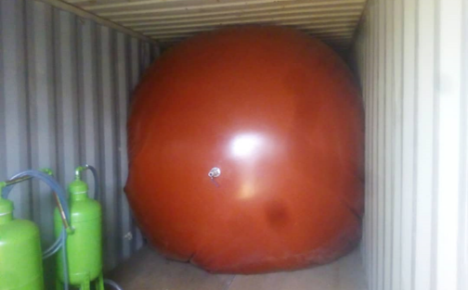
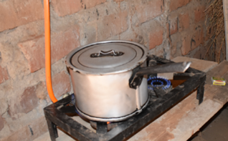
7. Adaptation Projects - Energy Cooperatives for Farmers
EC4F project supported small-scale farmers in Petauke to administer a biogas plant for energy for an irrigation system.
300 herd capacity cattle shed established linked to plant.
20 households cook on biogas
671 households (2 083 people) access clean drinking water
1 797 people gained knowledge in Animal Husbandry & Financial Literacy
07 Savings 7 Credit Coops formed and operating
28 Para-veterinarians trained.
EC4F ended in 2021 and has been reformulated and submitted to NAK-karitativ for an expansion phase.
OURPUT 6: High level of preparedness and ability to cope with shocks – by Communities and families that live in areas prone to disasters
Energy Cooperatives for Farmers (EC4F)

Slide 22
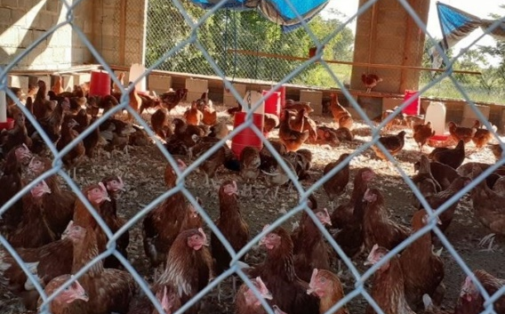
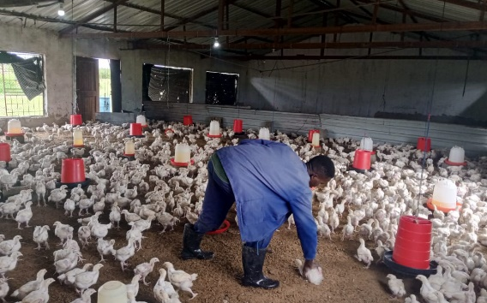
8. Organisational Development – Henwood Chibombo Farm
OURPUT 7: Consolidating our Internal Capacities
The farm performed well in 2021, sales of farm products grew by 31% from K707,788 in 2020 to K1,027,915 in 2021. Similarly, the farm performed well enough in 2022, the sales increasing marginally to K1, 044, 214, as summarised in the table below.
Increased and diversified resource base for programme implementation.
Serial No. | Products | Income (K)
1 | Broilers | 505 651.00
2 | Layers | 20 291.00
3 | Eggs | 344 497.00
4 | Pigs | 107 310.00
5 | Dry maize | 12 960.00
6 | Fresh maize | 7 153.00
7 | Cabbage | 17 993.00
8 | Tomato | 24 007.00
9 | Seedlings | 1 352.00
10 | Green pepper | 3 000.00
TOTAL |  | 1 044 214.00
HENWOOD CHIBOMBO FARM

Slide 23
8. Organisational Development – Agro-processing Factory
OURPUT 7: Consolidating our Internal Capacities
The factory’s main product is the Tomato Puree which has been stocked already by some outlets of the largest chain stores in Zambia, Shoprite, and other supermarkets such as Melissa. The performance of the factory enterprise in 2022, is outlined below.
Increased and diversified resource base for program implementation.
Production Line | 2022 Projections | Production Status | Production Status
Tomato puree | 15,000 units of 250ml bottles | 11,300 as of 28 July 2022 (75.33%). | Due to overstock, production was halted to avoid risk of product expiring
Dried mango | 2500x 30g. | 969 sachets were produced | There is market for bulk purchase of the product e.g., Umoyo Heath Products
Mango juice | Mango juice on trial basis | 138 x 160ml bottle | Trials & product sampling of the juice done; customer feedback good.
Dried tomato | 500 Sachets of dried tomato | 100 sachets were produced (20%) | Dried tomato line is still under product development. Informal market not that receptive of the product.
Peanut butter | 2500kg of peanut into peanut butter. | Not done | Production not commenced due to resource constraints
Tomato/Chili sauce | 600 tomato source/chili bottles | 108 x 270g bottles were produced | Product is self-marketing but need to make it stand out
Dried mushroom | Drying of 1000kg fresh mushroom | Not done | Need to package dried mushroom for sale to the formal market
Dried traditional vegetables. | 400kg of dried traditional vegetables | Not done | Need to package dried vegetables for sale to the formal market
AGRO-PROCESSING PLANT

Slide 24
8. Organisational Development – Chitenge Sales
OURPUT 7: Consolidating our Internal Capacities
The NAC Chitenge (wrappers) is a Church Brand managed by NACRO. The Chitenge sales grew by 195% in Zambia. This was spurred by the dampening effects on sales by the Covid-19 restrictions of 2020 when the pandemic was still nouvelle.
Chitenge sales in 2021; K 3,235,117.00 In 2020 the sales were K 1,095,949.00.
Increased and diversified resource base for program implementation.
CHITENGE SALES

Slide 25
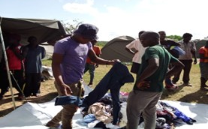
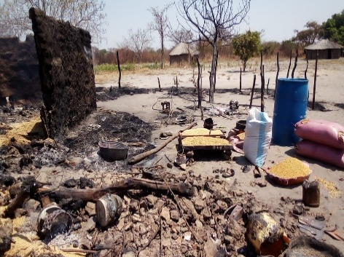
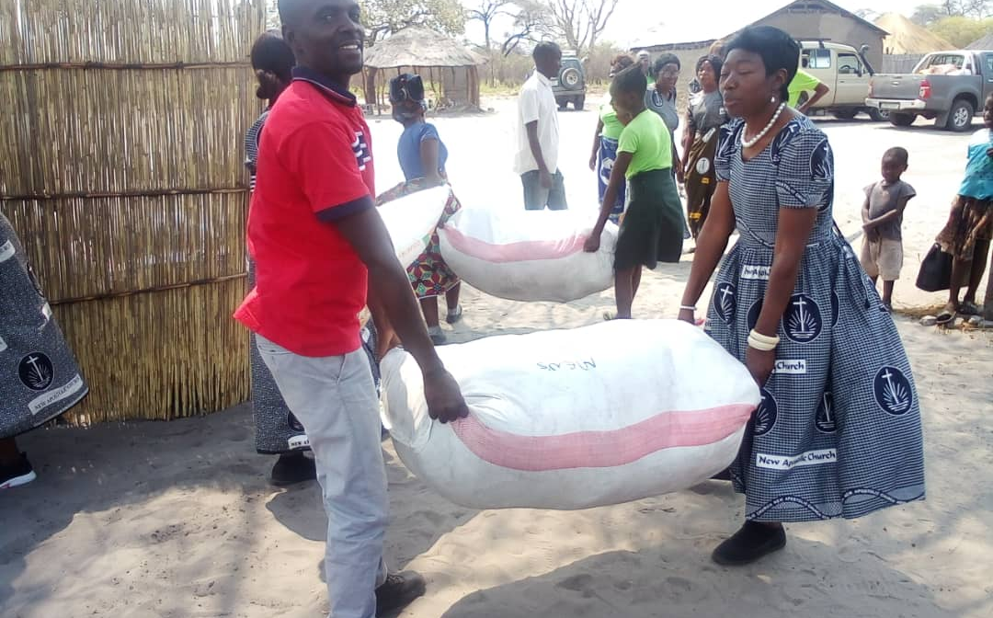
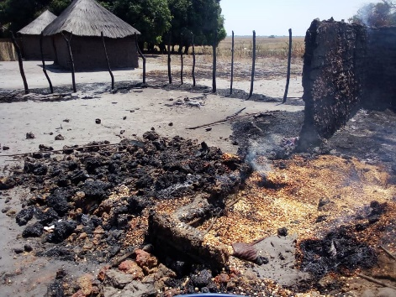
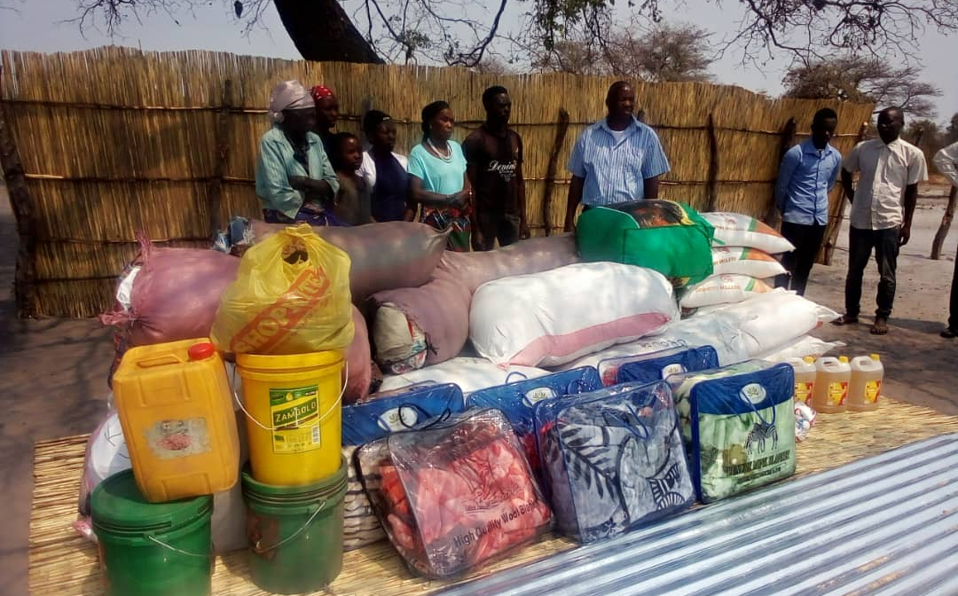
9. Response to Disasters in 2022
OURPUT 6: High level of preparedness and ability to cope with shocks – by Communities and families that live in areas prone to disasters
NACRO responded to two (2) disaster incidents involving flash floods in Namwala, Kalomo and Choma, Southern Province, and a fire incident in a village in Limulunga, Western Province.
NACRO provided food, hygiene kits, soaps and other basic life requisites to the flood victims; and food, clothing, & roofing sheets to the Limulunga victims.
Response to Limulunga fire incident was about K20,000, while that for Southern Province floods cost about K470,000..
The supplies rendered in both cases helped mitigate the sufferings of the affected people.
Response to Disasters

Slide 26
10. Prospective Projects
Expanded Energy Cooperatives for Farmers – Petauke
Chabota Training Centre Infrastructure Improvement Project - Chibombo
Basic Education Support Project – 3 NAC Schools Mansa, Kazungula & Limulunga
Gender & Social Inclusion (GESI) Project

Slide 27
11. Conclusion
Observations and Recommendations
Limited sources of funding. NACRO relies largely on one donor, which is putting the sustainability of organisation at great risk in terms of continuity of programmes and strategic choices. But given the similarity of work areas between NACRO and NAK-karitativ, the partnership[p can help NACRO grow a trusted track record that may attract external support and partnership. Common areas include health and education, which can be exploited further given the possible scaling in results. Also NAK-karitativ has good working relations with German agencies that have valuable experience providing solutions and business models NACRO can popularise.
Inadequate human resource capacities – in some critical areas such as projects management and financial management the capabilities of permanent and volunteers workers may need improvement to be more efficient and effective in programme implementation, but also in safekeeping of and accounting for resources at the disposal of the organisation – which will inspire trust from prospective partners who may want to work with NACRO. It is worth considering support to do a training needs assessment and implement appropriate in house staff trainings.
NACRO’s resource base is stagnating. This appears worsened by not having a specific unit within the organisation for business development. It is important for the function to be considered, resources allowing, as this function will explore and mobilise partnerships with interested organisations, and mobilise resources needed.

